Slide 1
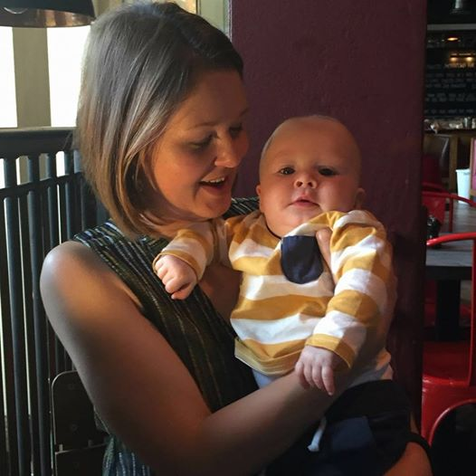
A personal journey through IBD
Nancy Greig, Health Policy and
Public Affairs Officer
Thursday 26th January 2017

Slide 2
Who are we?
We are the UK’s leading charity in the battle against Crohn’s Disease and Ulcerative Colitis. Founded as a patients association in 1979, we now have nearly 30,000 members across the UK.
Our members include those living with IBD, their families and friends, health professionals and others who support our work.
We are working to make life better for the 300,000 people in the UK with Crohn’s, Colitis and other forms of Inflammatory Bowel Disease.
The Charity’s core values, principles and vision underpin our services, our activities, who we are, the people we partner with and the people we serve.

Slide 3
What do we do?
We provide high quality information and support to help people manage their conditions. We believe people living with Crohn’s and Colitis should be able to live their lives to the fullest
We work with health services across the UK to improve diagnosis, treatment and management of IBD. We want everyone with these conditions to have access to the best specialist services
We support life-changing research to increase knowledge of the causes and the best treatments for Crohn’s and Colitis. We want to improve lives now and lead the mission to find a cure
We campaign vigorously – for more knowledge, better services and more support for our ongoing fight against IBD

Slide 4
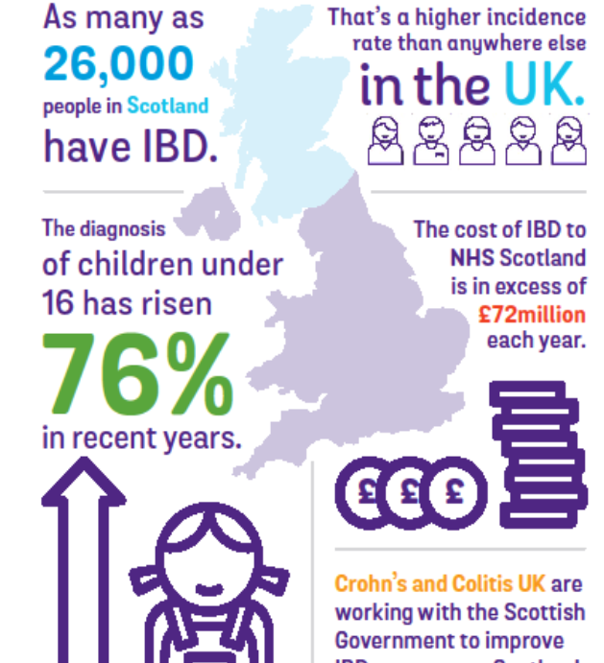
IBD in Scotland- Scotland Leading the Way
Scottish Government is committed to ensuring that people in Scotland living with IBD are able to access best possible care and support.
Incidence of IBD is highest in Scotland and increasingly affecting children and young people.
National Blueprint is the first of its kind in the UK.
We believe learning can be implemented across every NHS Board for improved, equitable and more sustainable services.

Slide 5
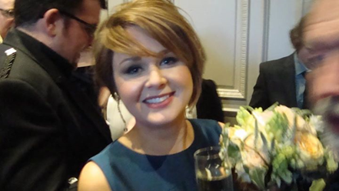
IBD-Why me?

Slide 6
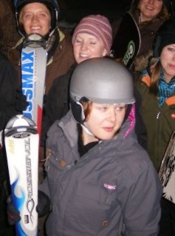
Diagnosis- the start of my IBD journey
To understand how and why I have ended up working for Crohn’s and Colitis UK, we need to rewind to 2007….
One of the first hurdles I faced was getting a diagnosis. Many patients report that their IBD diagnosis was only made after long periods of coping with difficult and distressing symptoms.
My GP did not use blood tests or fecal calprotectin to decide if I should be referred for endoscopy. Only took action after I mentioned family history of UC.
Lack of appropriate information and support at this stage. I left the UK to work in a ski resort in France with no arrangements for ongoing care or repeat prescriptions.

Slide 7
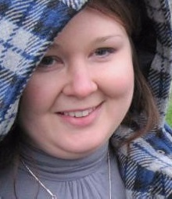
Maintaining remission
First serious flare hit in 2008. I ended up on a ward having IV steroids 400 miles from home.
Battled depression as I struggled with drug side effects and found myself unemployed as I abandoned career and travel plans.
Moved to Glasgow for new job and got involved with local group of Crohn’s and Colitis UK. Contributed to national volunteering and membership committee.
Bought first home with partner aged 34 but was refused life insurance!
Seriously ill for best part of 2 years, culminating in an emergency subtotal colectomy in 2011. I continued to work full time throughout this period.

Slide 8
Challenges with services
I clashed with new consultant and felt my symptoms were not ‘believed.’ Referred to psychiatrist who discharged me.
I did not respond to immunosuppressants and could not tolerate side effects.
My colitis spiralled out of control and no access to an IBD nurse, a helpline or rapid access clinic. I lost 2 stone in 3 months and was admitted twice for IV steroids.
No discussion of biologics or rescue therapy. Was starting to develop sepsis.
My colectomy was life saving but very traumatic. I lodged a formal complaint with Health Board then took it to SPSO, citing IBD Standards which were not met.

Slide 9
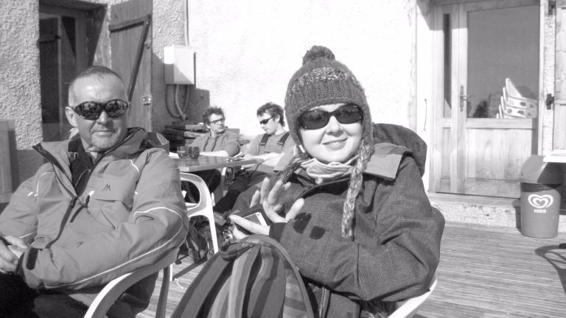
Ileostomy- a new lease of life but not plain sailing!
Having a stoma has made a massive impact on my quality of life, but still has its challenges.
Organisations like Crohn’s and Colitis UK and individual campaigners are breaking down barriers and challenging discrimination but still a lot of stigma.
In 2014 I had emergency surgery for a small bowel obstruction and then developed sepsis. I managed to get back to work after 2 months off.
Surgery left me with pelvic adhesions and unable to conceive. After 2 rounds of IVF and a healthy pregnancy my son was born in March 2016!

Slide 10
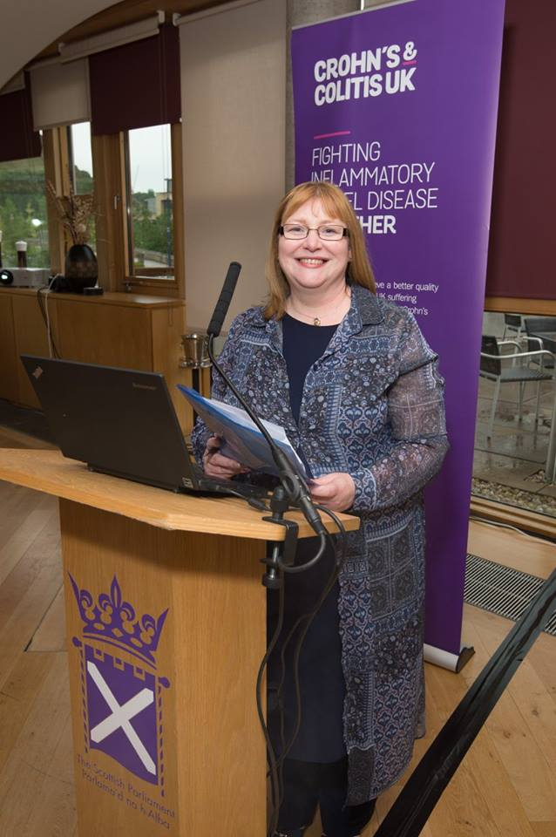
Working with Crohn’s and Colitis UK- a new chapter
After 7 years at the Health and Social Care Alliance Scotland, taking up a partnership role with Crohn’s and Colitis UK.
Involvement with the Service Development Steering Group has allowed me to hit the ground running! Over the next 3 years I will be:
Supporting the implementation of actions outlined in The Blueprint.
Supporting the Scottish IBD Nurses Network to develop their approach to the implementation of The Blueprint
Setting up and supporting a Cross Party Group in Parliament to disseminate good practice and monitor progress of The Blueprint.
Building on experience in Scotland to support a similar national approach to IBD Services in Northern Ireland.

Slide 11
Email: nancy.greig@crohnsandcolitis.org.uk Tel: 0141 404 0231 https://stv.tv/news/features/1354516-world-ibd-day-what-its-like-to-live-with-an-invisible-illness/

