Slide 1

Focus
On…
Critical Illness
Underwriting
Selection
Insert magnifying glass / puzzle with Focus picture here

Slide 2
Focus On…
Paul Reddick
30 years in the industry and haven’t changed a bit…

Slide 3
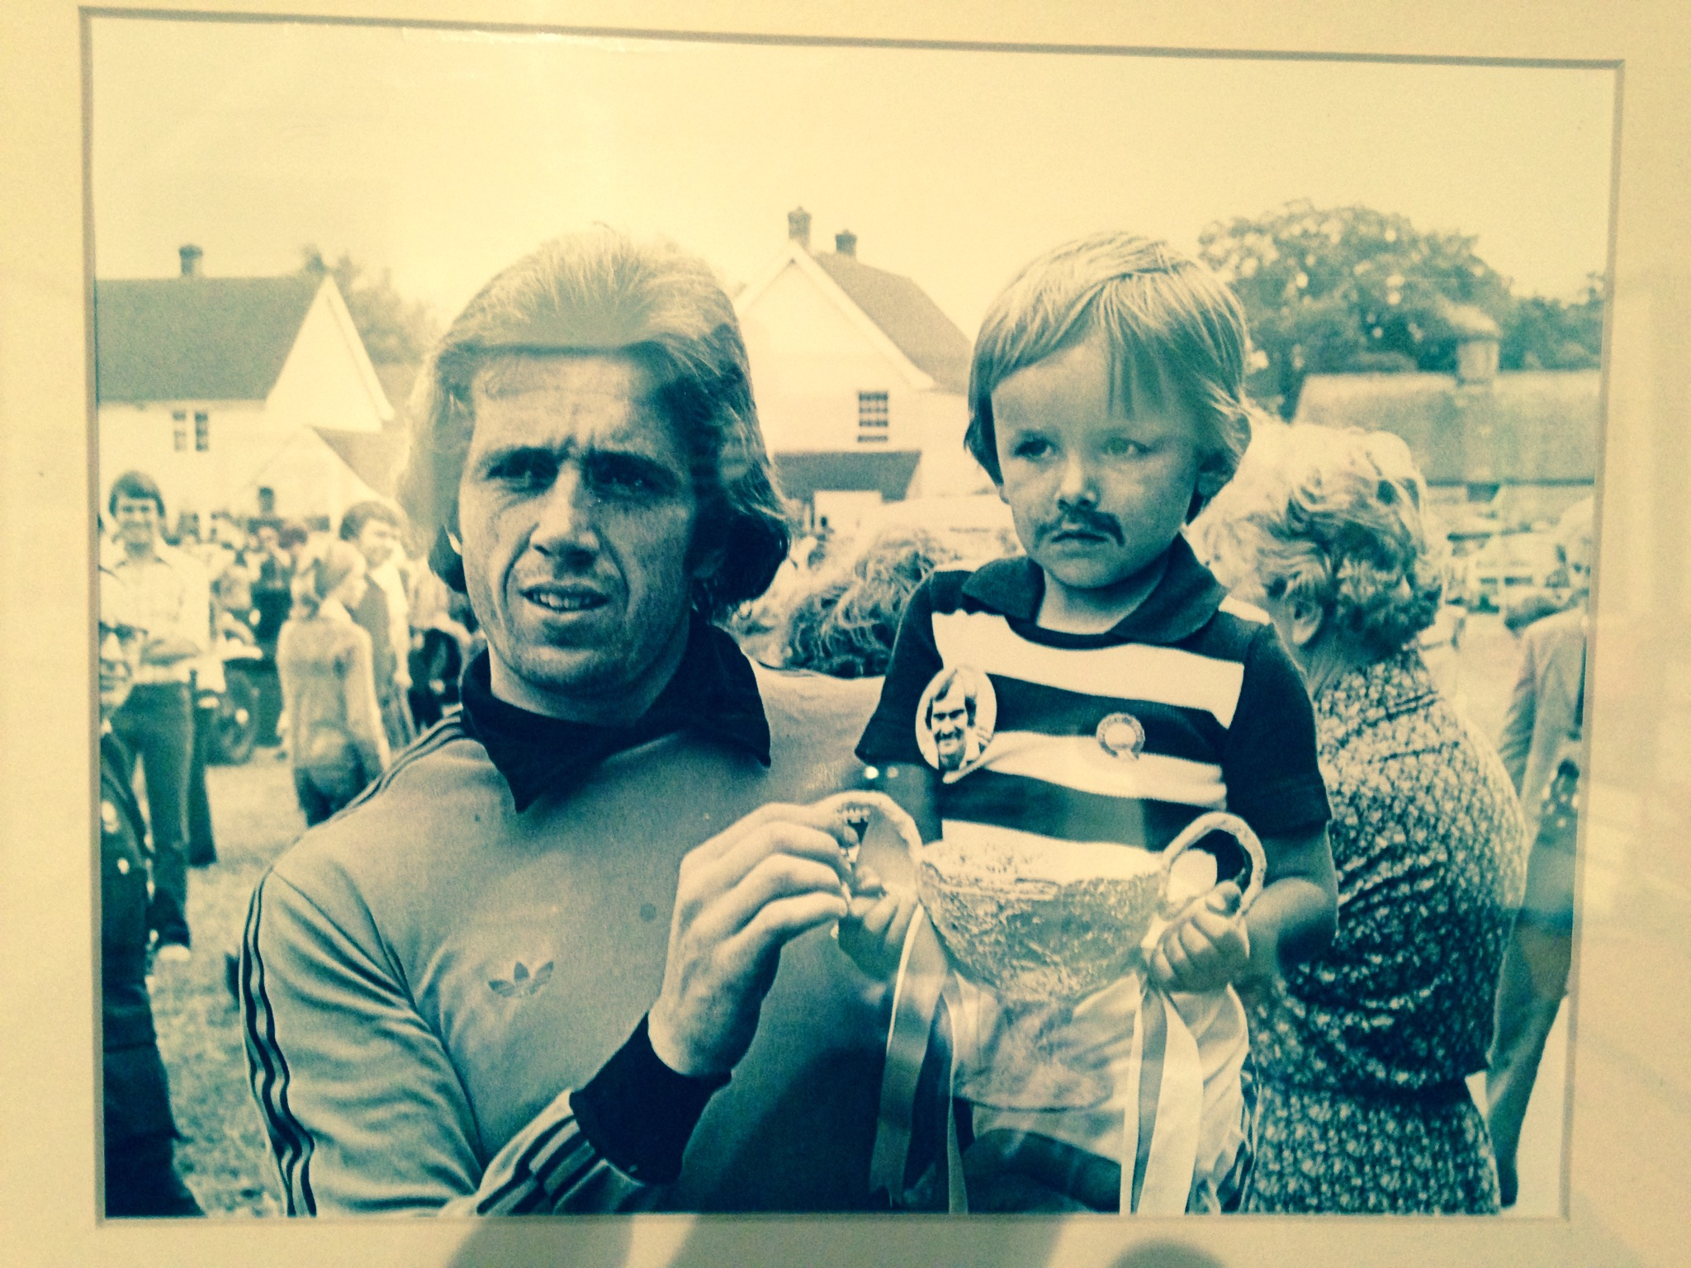
Focus On…
Carl Padget
…And neither have I!

Slide 4
  Our FOCUS…
  What we can learn from CI claims data
  Enhance our ability to recognise potential
  anti-selection
  Improve our underwriting of atypical risks

Slide 5




Focus On…
Average age at diagnosis
What is the average age of diagnosis for the following diseases?
Covered CI conditions are typically older aged diseases
Breast cancer?
Colon cancer?
Ischaemic heart disease?
55
64
56-58
Parkinson’s disease?
Motor neurone disease
Alzheimer’s disease
60-62
65-70
75

Slide 6

Focus On…
Population Vs Insured - Age
Study Details
        01/2010-06/2014
        1353 CI claims
The insured figures are from claims paid data so are already weighted to insured claim ages.
The population figures are based on incidence rates by age but
re-weighted according to an assumed insured claim mix
Condition | Average age at diagnosis (population) | Average age at diagnosis (claim) | Average duration from policy inception to diagnosis
Breast Cancer | 55 | 44 | 27 Months
Bowel Cancer (Male) | 64 | 47 | 29 Months

Slide 7


Focus On…
Population Vs Insured - Medical
Incidence Cancer (as % of all cancer)
Population versus Insured (claims)
Cancer site | Population Incidence | Insured (claims) Incidence | Difference
Breast | 37.8% | 54.6% | +44%
Testicular | 0.80% | 13.0% | +1525% (!)
Malignant Melanoma (Males) | 4.30% | 7.80% | +81%
Leukaemia (Males) | 2.70% | 6.50% | +140%
Hodgkin’s Disease (Male/Female) | 0.50% / 0.30% | 5.70% / 2.90% | +1040% / +867%
Brain Tumour (Males) | 1.80% | 3.40% | +89%

Slide 8
Focus On…
Cover Amount and Duration In-force
Analysis of 14,000 cancer claims by cause
    Average S/I £57,000
    Duration 0 = 1st year claims
    ‘Red’ cells are >average S/I
Cancer Type / Duration | 0 | 1 | 2 | 3 | 4 | 5+
Colon | 74,280 | 54,232 | 75,140 | 49,494 | 43,292 | 53,634
Melanoma of skin | 77,176 | 104,436 | 66,739 | 65,614 | 58,667 | 67,134
Prostate | 89,377 | 60,624 | 57,439 | 59,569 | 45,314 | 60,426
Site not specified | 77,789 | 76,036 | 73,887 | 71,454 | 57,554 | 86,160
Testis | 84,360 | 80,946 | 71,084 | 90,316 | 55,447 | 64,581
Trachea, bronchus and lung | 62,605 | 45,755 | 24,830 | 46,201 | 30,206 | 38,845
Other | 72,147 | 77,777 | 61,277 | 60,482 | 51,471 | 50,998
Unknown | 68,677 | 59,364 | 57,867 | 54,907 | 46,329 | 46,105
0 | 1 | 2 | 3 | 4 | 5+ | Total
130% | 95% | 131% | 87% | 76% | 94% | 102%
135% | 183% | 117% | 115% | 103% | 117% | 131%
156% | 106% | 100% | 104% | 79% | 106% | 103%
136% | 133% | 129% | 125% | 101% | 151% | 132%
147% | 141% | 124% | 158% | 97% | 113% | 132%
109% | 80% | 43% | 81% | 53% | 68% | 73%
126% | 136% | 107% | 106% | 90% | 89% | 108%
120% | 104% | 101% | 96% | 81% | 81% | 96%

Slide 9
Focus On…
Testicular Cancer
The most significant material difference in population incidence versus insured incidence
Highest above average sum assured cancer claim payment in the first 5 years
Risk factors:
  Cryptorchidism (3-4x risk)
    6.3x increased risk in unilateral cases
    1.7x increased risk in the other (descended) testicle
    1/44 lifetime risk in bilateral cases
  Infertility
    59% higher risk in sub-fertile men compared to those with normal fertility levels
  Family history
    8-10x increased risk if brother affected
    75% increased risk if an identical twin
  Smoking
    2x increased risk in 20 cigarettes a day x 12 years
Is our assessment of these risk factors effective?
Can this risk be mitigated within the application questions?
Source: cancer research / NHS

Slide 10
Focus On…
Cover Amount and Duration In-force
Analysis of 14,000 claims by cause
    Average S/I £57,000
    Duration 0 = 1st year claims
    ‘Red’ cells are >average S/I
Condition/Duration | 0 | 1 | 2 | 3 | 4 | 5+ | Grand Total
Death | 61,826 | 59,100 | 60,123 | 49,399 | 47,905 | 42,795 | 53,594
Benign Brain Tumour | 74,677 | 77,548 | 83,072 | 71,029 | 93,112 | 53,199 | 73,345
Coma | 61,005 | 50,166 | 73,504 | 47,083 | 60,947 | 106,385 | 63,288
CABG | 52,657 | 62,783 | 53,486 | 56,873 | 45,140 | 53,470 | 54,121
Heart Attack | 56,561 | 57,085 | 50,181 | 49,044 | 59,006 | 46,320 | 52,445
HVRoR | 111,684 | 77,445 | 72,912 | 99,183 | 55,035 | 49,242 | 69,316
Kidney Failure | 78,385 | 52,348 | 60,489 | 53,045 | 48,886 | 50,232 | 55,848
MOT | 75,375 | 58,752 | 71,070 | 8,144 | 33,001 | 81,649 | 72,051
MND | 86,690 | 36,354 | 44,981 | 103,335 | 78,892 | 63,124 | 74,112
Multiple Sclerosis | 78,056 | 67,490 | 74,987 | 59,547 | 54,560 | 61,544 | 65,913
Stroke | 65,005 | 52,994 | 48,319 | 64,592 | 51,407 | 50,506 | 55,285
TPD | 54,027 | 75,062 | 40,862 | 48,718 | 54,124 | 47,696 | 50,685
0 | 1 | 2 | 3 | 4 | 5+ | Total
108% | 103% | 105% | 86% | 84% | 75% | 94%
131% | 136% | 145% | 124% | 163% | 93% | 128%
107% | 88% | 128% | 82% | 107% | 186% | 111%
92% | 110% | 93% | 99% | 79% | 93% | 95%
99% | 100% | 88% | 86% | 103% | 81% | 92%
195% | 135% | 127% | 173% | 96% | 86% | 121%
137% | 91% | 106% | 93% | 85% | 88% | 98%
132% | 103% | 124% | 14% | 58% | 143% | 126%
152% | 64% | 79% | 181% | 138% | 110% | 130%
136% | 118% | 131% | 104% | 95% | 108% | 115%
114% | 93% | 84% | 113% | 90% | 88% | 97%
94% | 131% | 71% | 85% | 95% | 83% | 89%

Slide 11
Focus On…
Population Vs Insured - Medical
Incidence – Multiple Sclerosis
Population versus Insured (claims)
*Incidence and prevalence of multiple sclerosis in the UK 1990–2010: a descriptive study in the General
Practice Research Database
 | *Population Incidence | Insured (claims) Incidence | Difference
Multiple Sclerosis (Female) | 2.03% | 6.19% | +205%

Slide 12
Focus On…
The story so far
Critical illnesses are typically older aged diseases
Evidence indicative that CI is an anti-selective product with:
  Younger ages at diagnosis/claim
  More early duration claims than expected
  Above average CI sum assured claims in the early years
  Disproportionate number of insured CI claims Vs population
A clear sub-set of covered conditions that are targeted ‘hot spots’, in particular:
  Testicular Cancer
  Breast Cancer
  Colon Cancer
  Multiple Sclerosis
Specific areas of CI risk assessment in which we can help improve claims experience and profitability, including:
  Family history
  Investigations
  Neurological symptoms

Slide 13
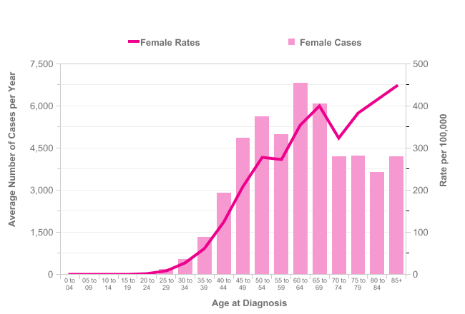
Focus On…
Incidence of Breast Cancer
2009-2011
Average Number of New Cases Per Year and Age-Specific Incidence Rates per 100,000 Population, females, UK
Approximately 4% of cases with significantly premature presentation of breast cancer
Atypical and suspicious of a dominant genetic issue
Source:

Slide 14
Focus On…
Family History
Current Breast Cancer Screening
Age | Standard Risk | Moderate Risk
 | No family history 1 first degree relative >40 | 1 first degree relative <40 2 first/second degree relatives with an average age of 50+ 3 first/second degree relatives with an average age of >60
 |  | Lifetime risk at least 17% but less than 30%
 | National Screening Programme | Secondary Care
20-29 | No Screening | No Screening
30-39 | No Screening | No Screening
40-49 | No Screening* | Annual Mammogram
50+ | 3 Yearly Routine Mammogram | Annual Mammogram
*Certain health authorities now invite females aged 47 years for 3 yearly routine breast screening

Slide 15

Focus On…
Current Breast Cancer Screening
Age | High Risk
 | Family history over and above that of “moderate” risk, which include: 1 first/second degree relative diagnosed with ovarian cancer at any age and 1 first/second degree relative diagnosed with breast cancer before 50. 2 first/second degree relatives diagnosed with ovarian cancer at any age
 | Lifetime risk at least 30% | >30% BRCA carrier but no test | >30% TP53* carrier but no test
 | Specialist genetic clinic
20-29 | No Screening | No Screening | Annual MRI
30-39 | Consider Annual Mammogram | Annual MRI Consider Annual Mammogram | Annual MRI
40-49 | Annual Mammogram | Annual MRI and Mammogram | Annual MRI
*TP53 = A gene that carries instructions to make tumour protein p53 (TP53). The protein acts as a tumour suppressor by regulating cell division through stopping cells from growing/dividing too fast or in an uncontrolled way.

Slide 16
Focus On…
Family History - Case Study
Life, Critical Illness and TPD £150,000
Female aged 45 years
Application disclosure:-
  Routine mammogram – normal
  Family history ovarian cancer – diagnosed 39 years
Decision?
  PLRE comment:-
  Mammogram performed before the routine screening age
  Reason for mammogram is not known
  Family history of 1st degree relative with ovarian cancer at any age
  Second degree family history not known

Slide 17
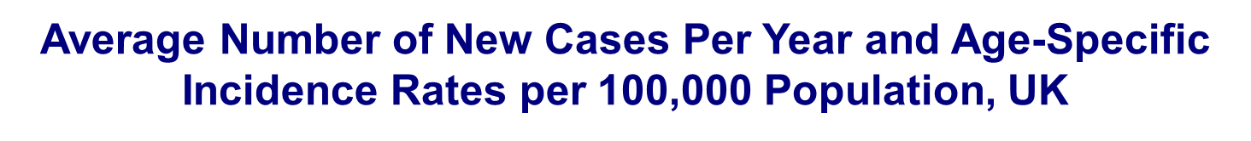
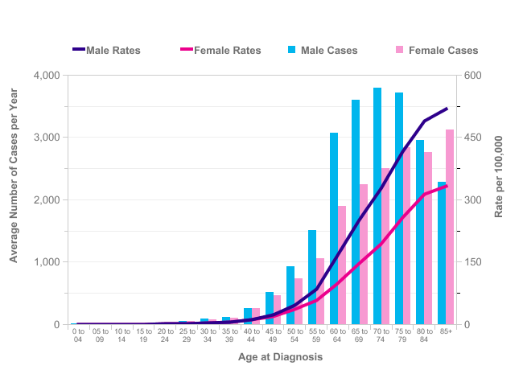

Focus On…
Incidence of Colon Cancer
2009-2011
Source:

Slide 18
Focus On…
Family History
Current Colon Cancer Screening
Moderate Family History Risk | Screening | Age at initial screening | Screening interval period
3 first degree relatives none <50 | Colonoscopy | 50 years | 5 yearly to age 75
2 first degree relatives mean age <60 | Colonoscopy | 50 years | 5 yearly to age 75
2 first degree relatives > 60 | Colonoscopy | 55 years | Once at age 55 no follow up if result normal
1 first degree relative <50 | Colonoscopy | 55 years | Once at age 55 no follow up if result normal
Routine UK screening is not before the age of 50 years
A colonoscopy is not typically performed for routine UK screening unless the FOB result is abnormal or unclear
Source: British society of gastroenterology

Slide 19
Focus On…
Family History
Current Colon Cancer Screening
High Risk Family History | Screening | Age at initial screening | Screening interval period
HNPCC | Colonoscopy OGD | Colonoscopy from age 25 OGD from age 50 | Colonoscopy 18 -24 months OGD 2 yearly
FAP | Colonoscopy or alternating colonoscopy & flexible sigmoidoscopy | Teens | Annual colonoscopy or alternating colonoscopy & flexible sigmoidoscopy until age 30
Peutz-Jeghers Syndrome | Colonoscopy OGD | From age 25 | Every 2 years
Juvenile polyposis | Colonoscopy OGD | Colonoscopy from age 15 OGD from age 25 | 2 yearly colonoscopy and OGD >35 years greater intervals
Source: British Society of Gastroenterology

Slide 20
Focus On…
Story so far
Atypical Screenings:
  Colon cancer screening before the age of 50 years - atypical!
  Screening by colonoscopy - atypical!
  Breast cancer screening before the age of 50* years – atypical!
  Annual mammogram screening - atypical!
  Breast MRI screening - atypical!
Atypical investigations:
Investigations or procedures performed indicate medical professionals are concerned regarding possible causes of symptoms - so should we!
In particular, further atypical investigations for consideration:
  Mole Mapping
  MRI Brain
  CTA/MRA
  Lumbar Puncture

Slide 21

Focus On…
Atypical Investigations – mole mapping
Mole mapping is performed when there is an increased risk of melanoma
This is not routine!
If clinicians are suspicious or concerned So should we!
There is usually a history of:-
    Previous excision of moles with existing ones present
  Multiple moles 50-100+
  Family history of melanoma
  Sun damaged skin
What does the applicant know that we don’t?
Mole mapping app now available on your phone!
https://play.google.com/store/apps/details?id=com.revsoft.doctormole&hl=en

Slide 22
Focus On…
Atypical Investigations – Case Study
Life, Critical Illness and TPD £240,000
Female aged 24 years
Application disclosure:-
  Dermatology referral 09/2013 – no treatment
GPR:-
  11/2011 - More than 100 moles present and needs mole mapping
  11/2013 - Mole mapping NAD and diagnosed with multiple naevi. Routine follow up planned
PLRE Comment:-
  Mole mapping is performed when there is an increased risk of melanoma
  >100 moles present
  PLRE would assess as Dysplastic Naevus Syndrome risk and exclude
  Real case accepted standard rates for CI

Slide 23
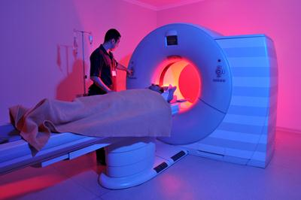
Focus On…
Atypical Investigations - Neurological
MRI/CT scans of the brain are performed for a reason
They are looking for a cause of symptoms
They are costly to perform (UK average circa £500)
It is not a pleasant experience for the patient ☹
What do these terms really mean?
  Essentially normal
  No significant abnormality
  Nil of significance
  Reassured
Lumbar puncture or CTA/MRA are usually second line as a follow up to imaging
They are invasive and unpleasant procedures
There is a risk of complication to the patient ☹
Therefore, medical professionals will not request these investigations unless they are concerned or suspicious – SO SHOULD WE!
Referral letters provide a better insight

Slide 24
Focus On…
Vague Neurological Symptoms
Red Flag | Amber Warning | Green Alert
Optic Neuritis Diplopia (double vision) Unilateral temporary blindness Nystagmus: uncontrolled eye movement (horizontal/vertical) Pain in the eye | Dysaesthesia Pins and needles Tingling Numbness Burning sensations Crawling sensations | Labyrinthitis Dizziness Vertigo
Lhermitte’s sign / Phenomenon Electric shock sensation passing down the back when moving the neck | Balance problems Lack of co-ordination Clumsiness Gait Fall / Unsteadiness | Tinnitus Hearing Loss
Trigeminal Neuralgia Unilateral or bilateral severe (sharp, stabbing, electric shock sensation) facial pain | Cognitive difficulties Memory / Confusion Concentration Attention Confusion | Fatigue TATT
Dysarthria/Dysphagia/Dysphasia Difficulties with speech/swallowing/words | Seizure/Fit Collapse / Vasovagal Loss of consciousness | (Simple) Faint
Bowel Incontinence Male urinary Incontinence | Weakness Paresis | Female urinary Incontinence
 | Visual Disturbance
 | Tremor

Slide 25



Focus On…
Vague Neurological Symptoms
Red
Flags
Amber Warnings
Green
Alert
Decline, Postpone or Exclude
Hospital letters and investigation reports are essential to consider any terms
Medical evidence with hospital letters and investigation reports

Slide 26

Focus On…
Context is key
Key
Onset | Years ago No changes | Recent onset Changes in presentation
Pre-Presentation | Apparent precipitating cause | No apparent precipitating cause
Presentation Nature of symptoms | Sudden onset No associated symptoms | Gradual onset Associated symptoms Symptoms develop
Duration | Seconds / Minutes / Hours | Hours / Days / Weeks+
Pattern | Acute One off Short lived | Persistent Chronic Intermittent recurrences Constant
Investigations Referrals | Clinical history Clinical exam Bloods | Specialist referral MRI brain/spine CTA/MRA Lumbar puncture
Risk Factors | No family history No associated risk factors | Family history
Context

Slide 27
Focus On…
Atypical Investigations – Case Study
Life, Critical Illness and TPD £300,000
Female 41 years
Application disclosure:-
  Blurred vision
  Headache
  Tiredness
GPR:-
  01/2012 - 2 consultations for loss of balance. Low in energy and exhausted all the time. Unable to snowboard on holiday due to poor balance. Felt to be vertigo at that time. Prescribed Prochlorperazine.
  06/2012 - Headache with blurring of vision. Unable to focus on text when reading a book. Considered to be a migraine variant.
  10/2013 – Feeling off balance over the last few weeks or so
PLRE Comment:- Context Is Key
  Multiple episodes of Amber Alert and Green Flag symptoms
  Duration of symptoms (weeks)
  Pattern of symptoms (persisting/chronic rather than acute/short-lived)
  Intermittent recurrences
Accepted standard rates for CI = CLAIM FOR MULTIPLE SCLEROSIS

Slide 28

Focus On…
Asking the right question
Are you awaiting the results of, or have you been advised to have, any medical investigations, tests or scans or have you any expectation of seeking medical advice or treatment in the near future?
Any condition affecting your stomach, oesophagus or bowel, for example crohn’s disease, ulcerative colitis?
Application form questions can be open to interpretation by:-
  The insurer
  The consumer
  The ombudsman
Terminology potentially impacting on claim experience:
  Intention or expectation
  Condition, disease or disorder
  Problem
  Suffering or suffered (from)
  Affecting
  Medical advice
There is a growing importance on communication between underwriters and claims
  Application questions
  Exclusion wording
  CI definitions
CLAIMS
Underwriting
Notes:
X3 examples of application form questions
The application form is key to capturing the right risks.
If we don’t ask the right questions we wont get the disclosures in the first place to reveal the red flag risks for us to assess
Application form questions can be open to interpretation – therefore we need to ensure questions asked on the application form will be interpreted as intended.
This is our first line of defence to protection -
Close contact with our claim team allows us to understand our claim experience and appreciate the challenges our assessors face:
One of the key issues highlighted is application form terminology:-
If we don’t ask the right questions, FOS will overturn our decision and claim payment
TERMINOLOGY IMPACTING ON CLAIMS EXPERIENCE:-
Experience has shown us that it is difficult to prove “intention” or “expectation”
An applicant may not consider the risk to be a condition or disorder – particularly if they have not had a diagnosis
Difficult to prove it is a problem to the applicant
Suffering / Suffered (from) – difficult to define suffering and/or prove they are or were “suffering”
Affecting – difficult to prove this is affecting them
Medical advice – this term relies on specific “advice” being given by a medical professional and a general consultation often falls outside of this (e.g. a chat with a GP about a mole may not contain any actual advice)
Disease – may not be considered a disease (e.g. disc degeneration of the spine)
Is the application form designed linked to early claim experience?
Do underwriters read the application question and disclosure or just the disclosure?

Slide 29
A Final Focus On…
Critical Illness Conclusion
When comparing insured lives to the general population, for certain conditions, we are seeing:-
Materially higher proportions of claims…
Significantly lower age at diagnosis…
Cover levels purchased being higher than average…
Duration from inception to claim being lower than expected…
  So, what can we learn from this?

Slide 30
A Final Focus On…
Critical Illness Conclusion
Evidence suggests CI is at high risk of anti-selection
Technology and medicine have evolved since the CI product was launched so insurers need to remain one step ahead of the consumer
We need to ensure application form questions, terminology and automated underwriting rules evolve with ‘real-world’ claims experience
    And finally…………..
Underwriters continue to play a key role in safeguarding their office experience (and rates) by preventing avoidable claims through:-
  Identifying potentially anti-selective purchase behaviour
  Detecting atypical risks
  Obtaining the right evidence on atypical risks
  ASK YOURSELF: IS THIS TYPICAL OR ATYPICAL?

Slide 31
Focus On…The Panel
Any questions?

