Slide 1
PROTECTION UNDERWRITING AND CLAIMS:
EVERYTHING CHANGES BUT YOU
Scott Cadger
Toby Bainbridge
Views are our own, no link to corporate policy and absolutely no link to how to consider pricing reinsurance business for us!

Slide 2
AGENDA
Why underwrite
Historic approaches
What has changed in last 20 years
Where does the future lie?
How to react

Slide 3
What is the point of underwriting?

Slide 4
Historic approaches - UW
Historic Scottish Widows application
Points to note:
One page
Wet signature to validate
Policyholder attests rather than answer questions

Slide 5
Historic approaches - UW
Have you ever had section of form
How different is this to current “Have you ever had” section of application forms?

Slide 6
Historic approaches - UW
Travel and Armed Forces
How different is this to current approach to excluding particular travel and Armed Forces?

Slide 7
Historic approaches - UW
Avocation, Suicide and Mis-representation
How different is this to current approach?

Slide 8
Historic approaches - CLAIMS
First SW death claim paid in 1816
Letter received with death certified into head office.
Reviewed by Board and funds paid out within 3 months
Has much changed:
Intimation approach?
E2E times?
Evidence needed?

Slide 9
But we have changed some things?
Point of Sale Decisions

Slide 10
But we have changed some things?
Channel Differentiation
Many subgroups, but do we distinguish approach in underwriting and claims?

Slide 11
But we have changed some things?
Claims
User / charity supplied evidence
Improved claims paid out ratios
Telephone not paper – start of digitisation?
BUT
Still predominately manual exercise
Always the poor cousin when it comes to investment

Slide 12
What does the future hold?
Insurance underwriters
Likelihood of automation in next 2 decades?
It's fairly likely (66%)
http://www.bbc.co.uk/news/technology-34066941

Slide 13
A new underwriting approach?
Traditional
Online Rules
Predictive Underwriting

Slide 14
Predictive Analytics
Pattern recognition
Iterative
Unguided
Utilises computing raw power
Not “artificial intelligence”

Slide 15
Scary types of data?
Socio-demographic markers
Property value
Affluence
Lifestage
Education level
Lifestyle factors
Activity levels
Risk tolerance
Hobbies & interests
Media consumption

Slide 16
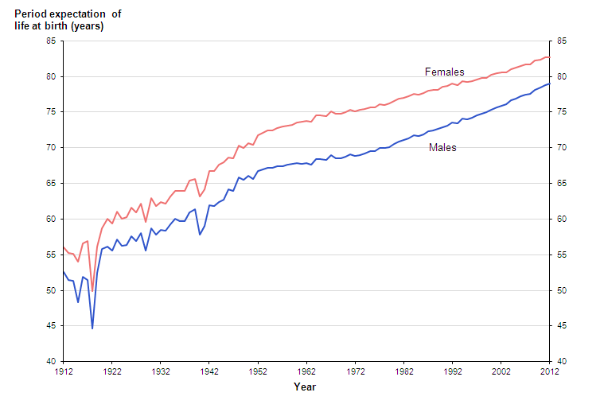
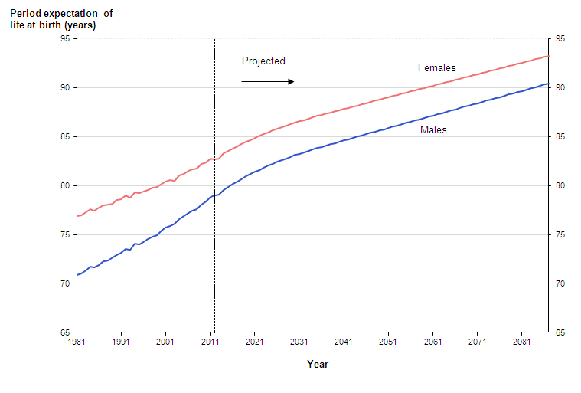
Are we concerned about mortality?
Source: ONS Mortality, 2012-based NPP Reference Volume

Slide 17
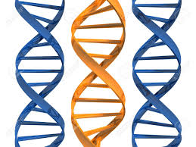
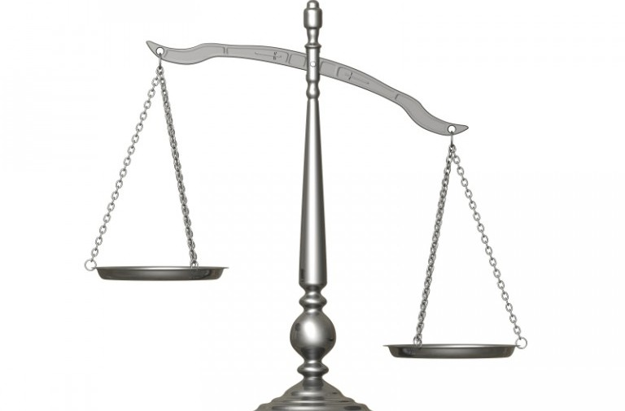
Where will genetics play a part?
Insurer
Anti-selection
Preventative
treatment?
Customer

Slide 18
The brave new world
Adapt – new skills (data mining, empirical evidence not just gut and experience), paid more
Adopt – use tech as an enabler not a concern
Specialists – fewer people, deeper specialism, paid more
New roles – product experts, system developers, multi-skilled

Slide 19
QUESTIONS / COMMENTS / CHALLENGES

